Slide 1
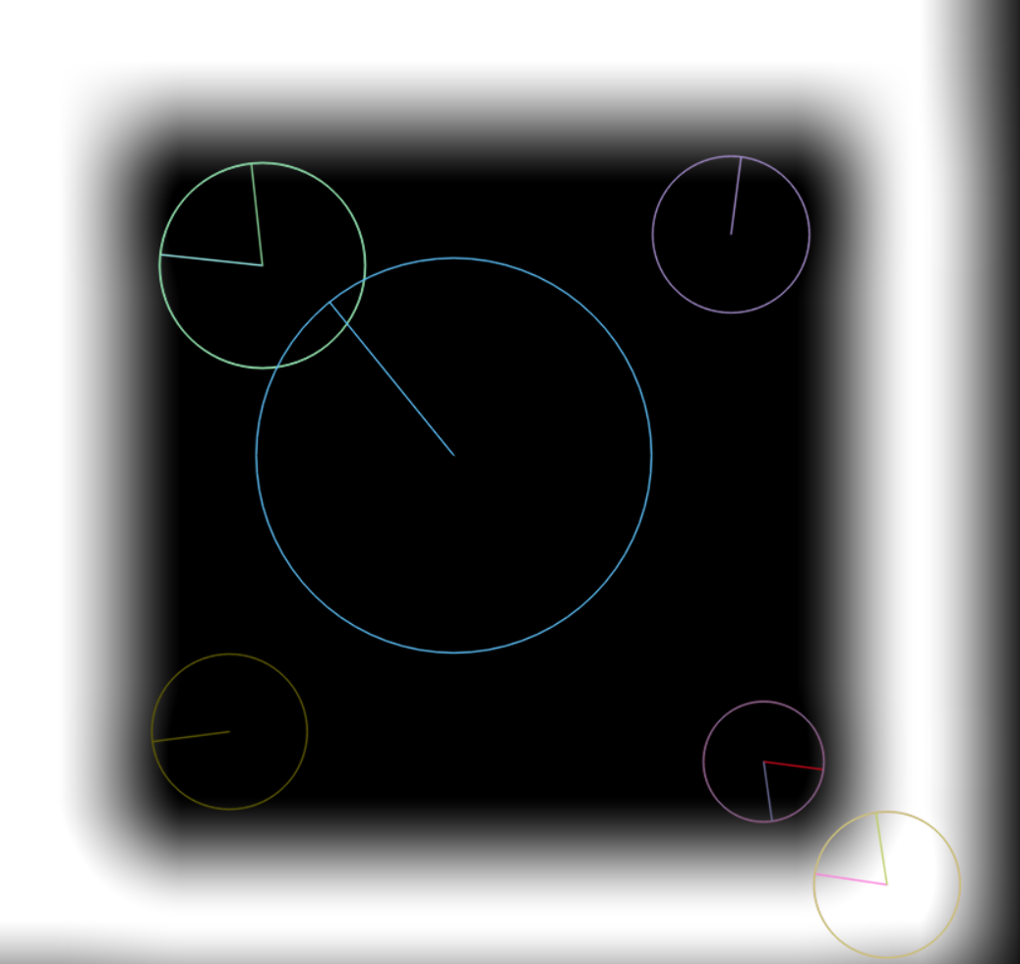
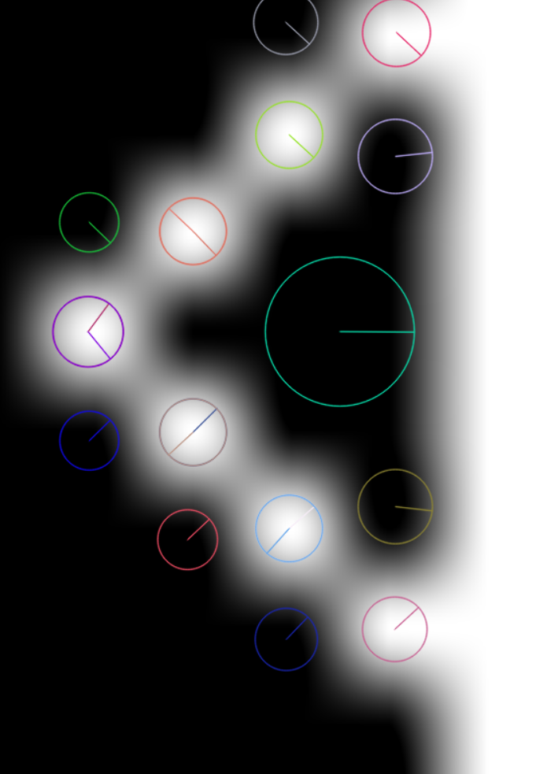
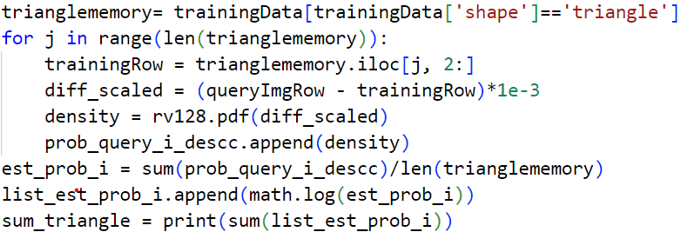
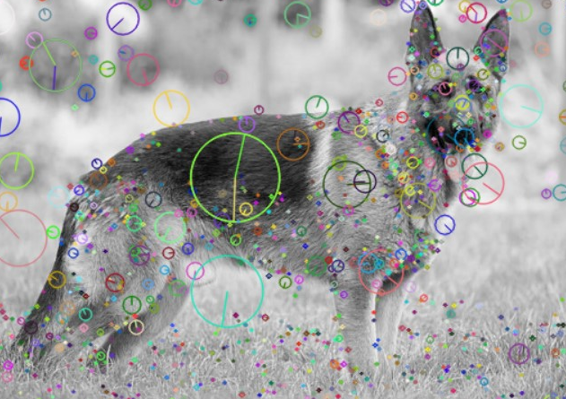
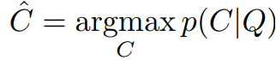
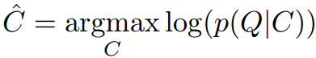
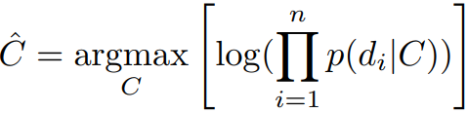
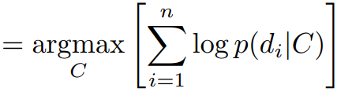
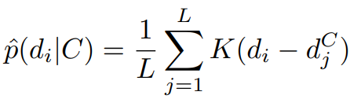

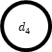

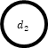

Leveraging SIFT for Explainable AI: A Naive-Bayes Nearest Neighbor Approach
Researcher: Nyah pee Advisor: Ivan Dungan Ph.D
Abstract:
The increasing use of AI in all disciplines has highlighted the necessity for transparency and results that can be understood. This research utilizes the Scale-Invariant Feature Transform (SIFT) algorithm, Naive-Bayes Nearest Neighbor (NBNN) Classifier, and aims to provides explainability using a probability density function (PDF). The SIFT algorithm extracts essential features, known as keypoints and descriptors, from a query image. The notable features are then classified based on the likelihood of the feature occurring in each class, due to the Naive-Bayes Nearest Neighbor method. Lastly, a probability density function is applied to provide an estimation of feature relevance and to which class the image belongs to. Our model demonstrates that this approach can provide transparency and proper explanation of the AI model's decision making. The forthcoming objective of this project is to be implicated in the discipline of healthcare through way of wound imaging.
Data:
Triangle/Square Images (Jordan Hinson 2024)
Wound Images (chronicwounddatabase.eu)
Background:
Scale-Invariant Feature Transform (SIFT) Algorithm (David G. Lowe): Computer Vision Algorithm used to detect and describe local features in an image
Naïve Bayesian Network: Bayesian network used for classification assuming that all features are conditionally independent.
Hardware, Software, and Libraries:
Processor: 13th Gen Intel(R) Core(TM) i7-1355U 1.70 GHz
Installed RAM: 16.0 GB (15.6 GB usable)
System type: 64-bit operating system, x64-based processor
Python:
OpenCV
Pandas
NumPy
Methodology:
Processed a series of triangle and square images by converting the images to grayscale, resizing, and converted them to a format suitable for Open CV. SIFT, then detects Keypoints in the images and outputs descriptors which are vectors with the dimensions of 128 x 1.
Classification:
Probability Density Algorithm:
Our algorithm aims to apply a quantitative value to feature relevance. The similarities between the query and training image is scaled to control the magnitude then calculated into a probability. The average of the probability then has Log applied and the final answer is the sum of all these values.
Conclusion:
Although this research is still in progress, the integration of the SIFT algorithm, Naïve Bayes Nearest Neighbor approach, and the application of our probability density algorithm, shows potential to aid the explainability of AI in image analysis.
Future Work:
K- fold cross validation
PDF into heatmaps
Handling more complex images
References:
[1] S. McCann and D. G. Lowe, "Local Naive Bayes Nearest Neighbor for image classification," 2012 IEEE Conference on Computer Vision and Pattern Recognition, Providence, RI, USA, 2012, pp. 3650-3656, doi: 10.1109/CVPR.2012.6248111.
[2] Lowe, D.G. Distinctive Image Features from Scale-Invariant Keypoints. International Journal of Computer Vision 60, 91–110 (2004). https://doi.org/10.1023/B:VISI.0000029664.99615.94
[3] Thomas, S. (2014, February 6). Medetec wound database: Stock pictures of wounds. Pictures of wounds and surgical wound dressings. https://www.medetec.co.uk/files/medetec-image-databases.html
Acknowledgements:
This work was supported primarily by the National Science Foundation EPSCoR Program under NSF Award #OIA-2242812. Any Opinions, findings and conclusions or recommendations expressed in this material are
those of the author(s) and do not necessarily
reflect those of the National Science Foundation.
[[ 0. 2. 19. ... 0. 0. 2.]
[ 3. 1. 86. ... 0. 0. 0.]
[ 9. 5. 32. ... 0. 0. 1.]
...
[ 0. 6. 29. ... 0. 0. 0.]
[ 0. 0. 0. ... 13. 0. 0.]
[16. 0. 0. ... 0. 0. 0.]]
[[33. 2. 0. ... 0. 0. 0.]
[ 0. 0. 0. ... 0. 0. 4.]
[ 1. 1. 1. ... 0. 0. 1.]
...
[ 3. 0. 0. ... 6. 3. 3.]
[ 0. 0. 0. ... 0. 3. 12.]
[68. 13. 0. ... 0. 0. 0.]]
$$d_{1}$$
$$d_{2}$$
$$d_{3}$$
Class
$$d_{4}$$
$$d_{n}$$
Density Estimation:

